Slide 1

Beyond Profit: Building Sustainable Businesses
Duration: 2 Hours | Target: BBA & MBA Students
01
Understand Sustainability
What it means in business context
02
Balance Profit & Purpose
How companies do both successfully
03
Discover Models
Sustainable business approaches that work
04
Practice Decisions
Consider people and planet impact

Slide 2

Your Sustainability Experience
Shopping Choices
Do you consider environmental impact when buying?
Price Premium
Would you pay more for sustainable products?
Priority Ranking
Price, quality, or environmental impact?
Quick Share: Name one way you personally try to be sustainable

Slide 3


What is Business Sustainability?
Traditional Focus
Sustainable Focus
Maximize profit
Profit while helping society
Keep costs low
Long-term costs & benefits
Shareholders only
All stakeholders matter
Short-term thinking
Plan for the future
Key Point: Not choosing between profit and doing good—doing both simultaneously

Slide 4






The Triple Bottom Line
Planet (Environmental)
Reduce waste & pollution
Renewable resources
People (Social)
Fight climate change
Fair wages & safe conditions
Community support
Diversity & inclusion
Profit (Economic)
Stay profitable
Create jobs
Shareholder value
Success = Excellence in all three areas

Slide 5

Why Sustainability Matters Now
73%
83%
18%
Consumer Premium
Millennial Priority
Higher ROI
Sustainable companies outperform
Would pay more for sustainable products
Consider environmental impact when choosing employers
Bottom Line: Sustainable businesses often perform better financially

Slide 6

Meet GreenTech Solutions
Company Profile
Current Challenges
200 employees, $50M revenue, software for businesses
Rising energy costs (20% of expenses), talent competition
Market Pressure
Customer sustainability questions, investor ESG demands
CEO's Challenge: How can GreenTech become sustainable while maintaining profitability and growth?

Slide 7






Understanding Stakeholders
Shareholders
Customers
Want financial returns
Want quality & ethical practices
Employees
Community
Want fair treatment & meaningful work
Want positive local impact
Government
Environment
Want compliance & tax revenue
Needs protection for future
Challenge: Balance different needs when they conflict

Slide 8
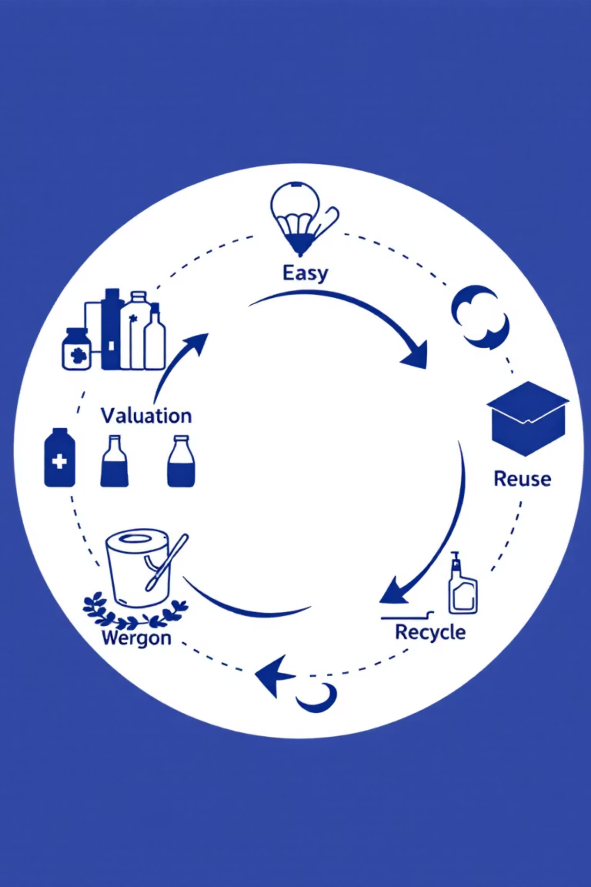



Sustainable Business Models
Circular Economy
Reuse materials, design for longevity. Example: Patagonia repairs clothes
Sharing Economy
Multiple users, reduced consumption. Example: Car sharing services
Service-Based
Sell services not products. Example: Philips "light as a service"

Slide 9


Measuring Sustainability Success
Environmental
Social
Economic
Carbon footprint
Employee satisfaction
Long-term profitability
Energy consumption
Community investment
Efficiency savings
Waste reduction
Diversity statistics
Risk reduction
Brand value increase
Water usage
Fair trade practices
Remember: What gets measured gets managed

Slide 10




Your Sustainability Journey
Build Skills
Learn sustainability metrics, stakeholder communication, systems thinking
Network & Research
Interview professionals, join organizations, study industry leaders
Take Action
Apply concepts in projects, choose sustainable companies, make impact
Key Takeaway: Sustainability knowledge is valuable in every industry—start building these skills now

